Slide 1

ARYA'S DOMAINVERSE 1.0
SupportFlow AI
AI-Powered Multi-Agent Customer Support System
EXPLORE | SOLVE | INNOVATE | BEYOND LIMITS
Creator Information
Event Details
Created by: Himanshi Chouhan
Roll number: 24EACCA033
Branch: CSAI
Batch: Alpha
6-Day Technical Problem-Solving Program
Arya College of Engineering (ACE)

Slide 2
The Problem
🧩 Fragmented Issues
🔀 Manual Routing
📂 Scattered Data
Orders, payments, refunds, deliveries — each a separate silo
Human intervention needed to direct every request
Relevant info spread across disconnected sources
🐌 Slow Resolution
📋 One-Size-Fits-All
Customers demand fast, accurate, understandable answers
Generic workflows fail diverse support needs

Slide 3

Our Solution: SupportFlow AI
A multi-agent system where a Coordinator understands customer requests and routes them to specialist agents. Business operations are deterministic and database-backed — the LLM handles natural-language understanding only.
Customer Query
Coordinator
Specialist Agent
Backend Tool

Slide 4
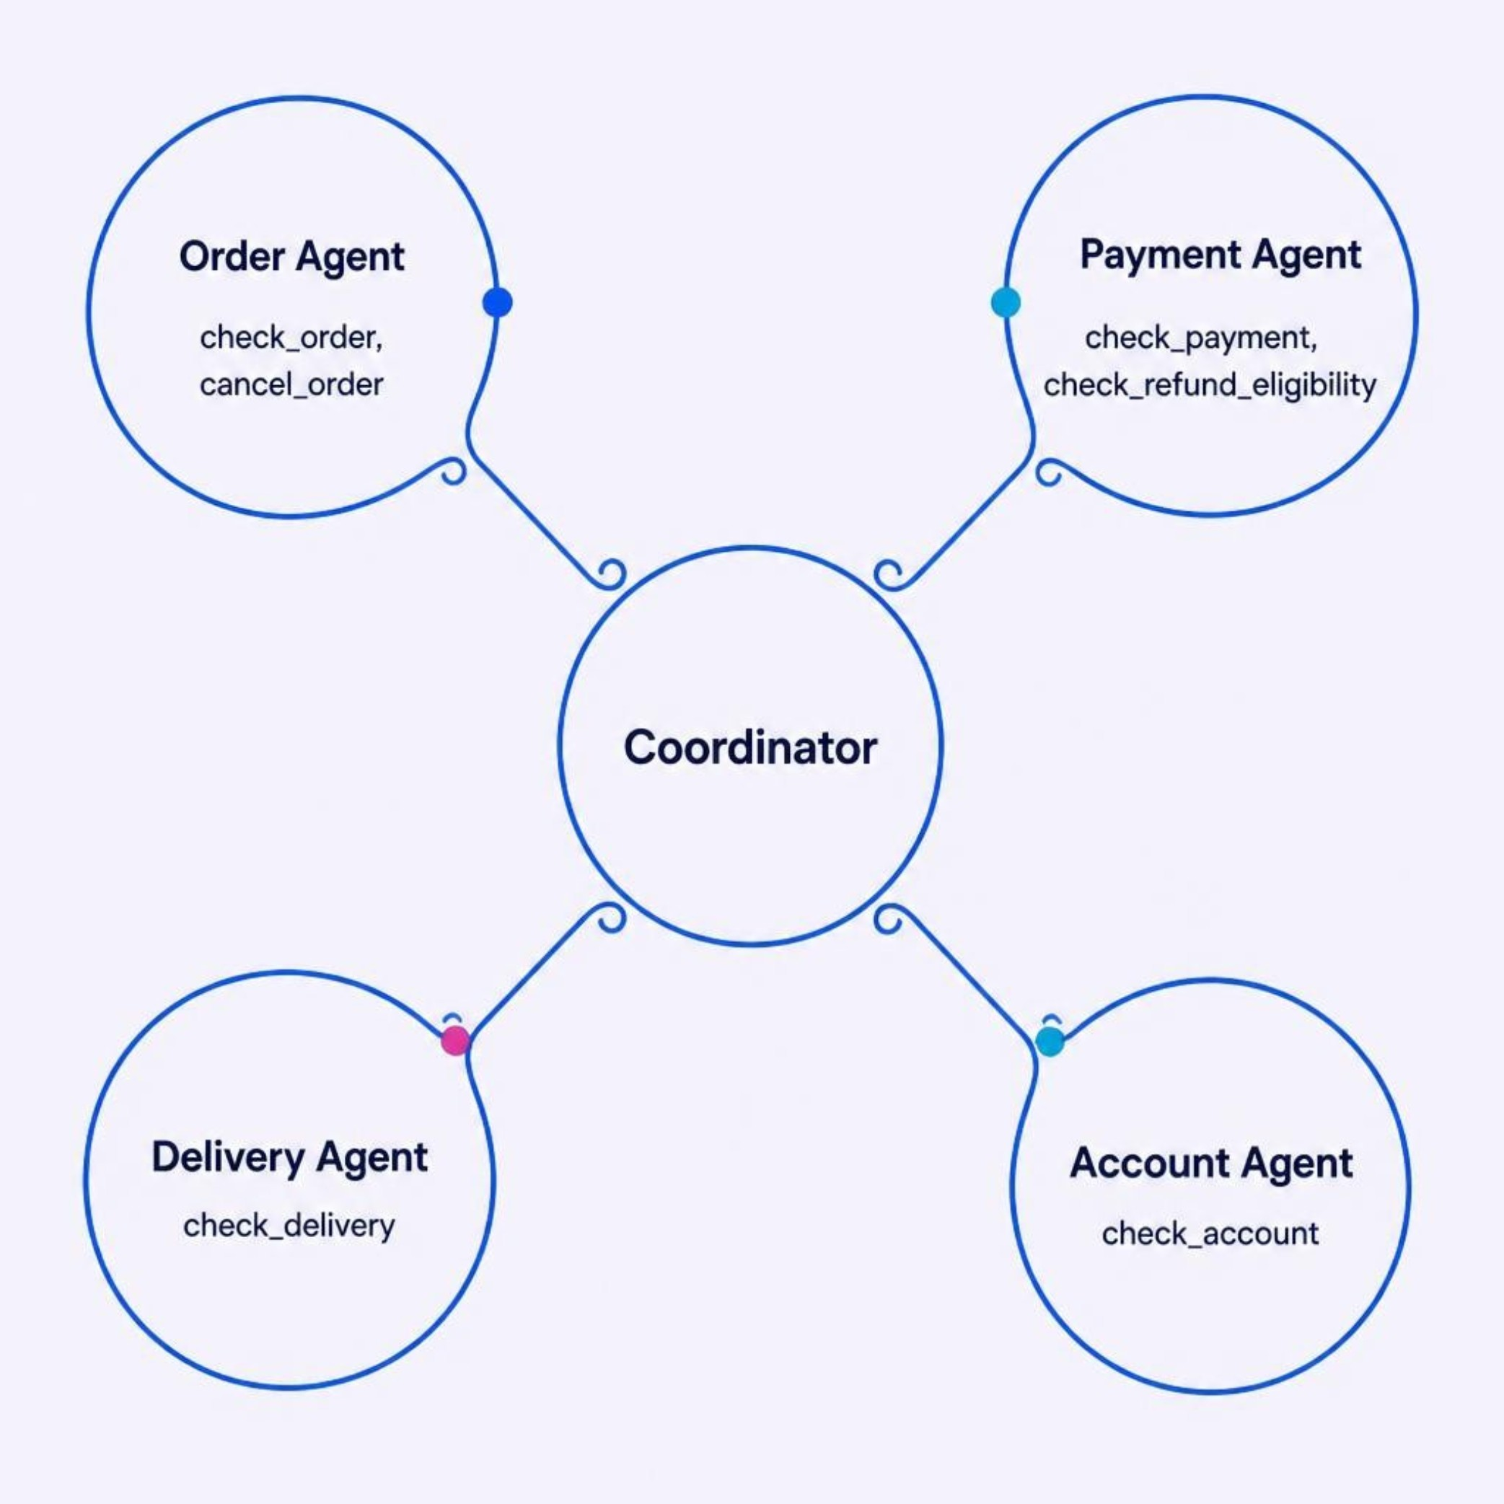

Multi-Agent Architecture
Coordinator
Understands intent, routes to specialists, orchestrates multi-agent workflows
Order Agent
Payment Agent
check_order · cancel_order
check_payment · check_refund_eligibility
Delivery Agent
Account Agent
check_delivery
check_account
Coordinator detects intents and routes requests to the relevant specialist agents.

Slide 5

Intelligent Coordination
Live Example
Customer says:
"Payment was successful but my order is still pending."
Execute Tools
Run checks and actions
Payment Agent
Select Specialists
Checks payment status — confirmed successful
Route to appropriate agents
Detect Intent
Identify needed intents
Coordinator re-plans
Understand Query
Detects residual order issue, activates Order Agent
Capture customer issue
Order Agent
Checks order status → Final resolution generated

Slide 6
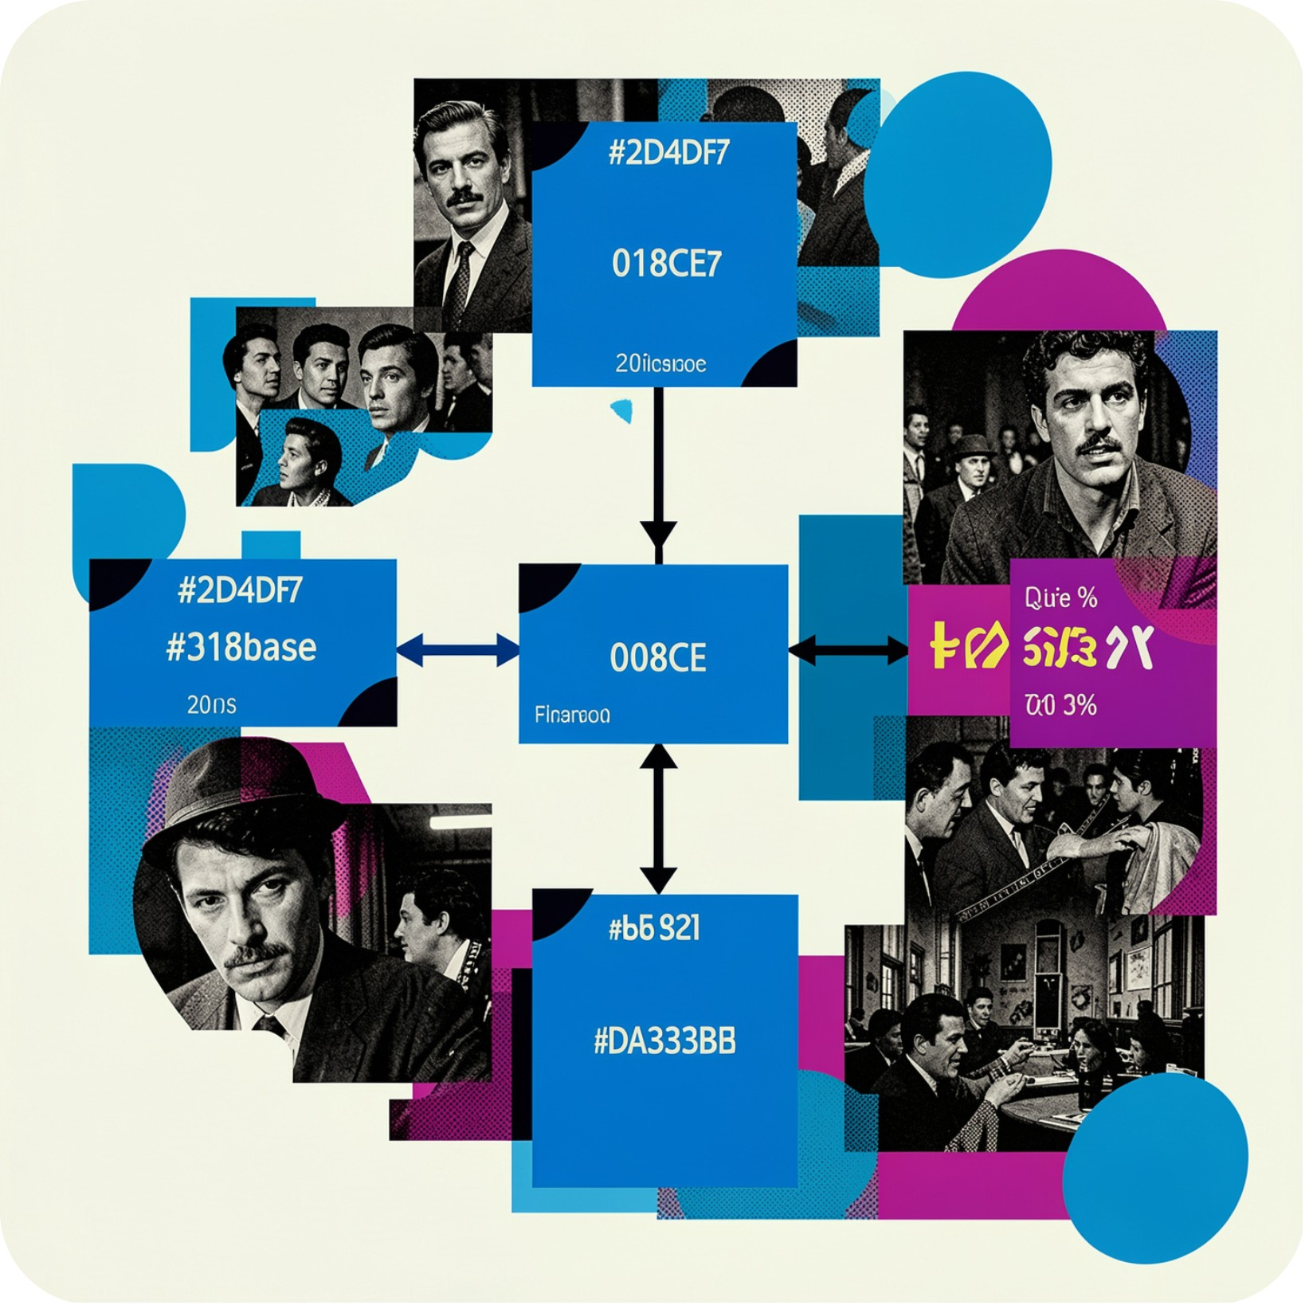
Backend & Data Layer
PostgreSQL Architecture
Core Tables
Relationships
Technology Stack
Customers · Products · Orders · Payments · Deliveries
Customer → Orders → Products | Orders → Payments | Orders → Deliveries
SQLAlchemy ORM · FastAPI backend
Data Integrity
Foreign-key relationships + deterministic business rules ensure consistent, verifiable operations

Slide 7
Technology Stack
Frontend
Backend
Database
Streamlit
FastAPI
PostgreSQL
ORM
AI/LLM
Language
SQLAlchemy
Google Gemini API
Python
Configuration
Python-dotenv / Environment Variables

Slide 8

Tools & Business Logic
Order Tools
Payment Tools
check_order — retrieve full order status
cancel_order — execute cancellation with eligibility check
check_payment — verify transaction status
check_refund_eligibility — apply business refund rules
Delivery Tools
Account Tools
check_delivery — fetch delivery status and tracking data
check_account — return safe profile info; auth-sensitive data excluded by design
Design Principle: Tools perform actual database operations. Agents decide which tool is relevant. The LLM never touches business logic directly.

Slide 9

AI & LLM Integration
Gemini's Role
Deterministic Layer
Interpret customer queries in natural language
Generate clear, human-friendly resolutions
Offline fallback available when API key is not configured
All core business rules live in tools — not the LLM
Database operations are verifiable and consistent
AI understands language; agents enforce logic

Slide 10

Customer Experience
Seamless Support Flow
01
Customer enters issue
Simple text interface — no complex forms
02
System processes intelligently
IDs (Order ID, etc.) requested only when needed
03
Backend checks all domains
Agents query relevant data sources in parallel
04
Customer sees final resolution
Internal logs, debug info, and agent workflows stay hidden

Slide 11
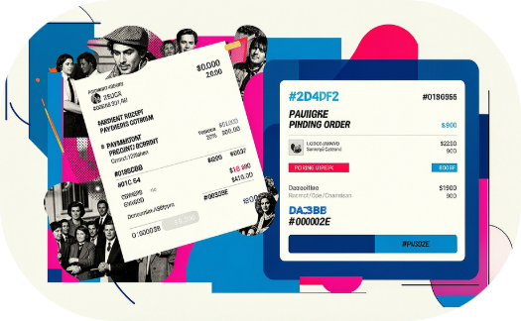

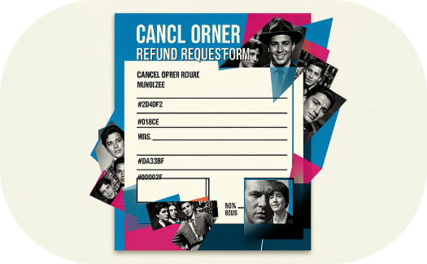
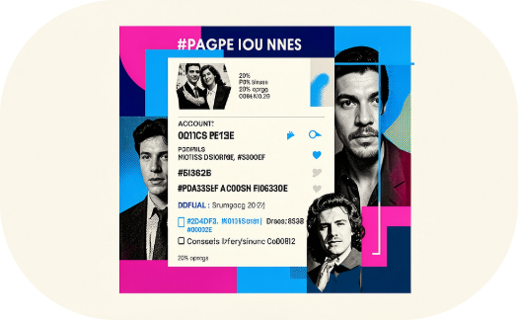
Real-World Demo Scenarios
💳 Payment vs. Order
📦 Package Tracking
🔄 Cancel + Refund
👤 Account Details
"Payment was successful but my order is still pending." → Checks payment + order → resolves discrepancy
"Where is my package ORD009?" → Checks order + delivery → returns live status
"Cancel my order and check if I get a refund." → Checks eligibility → checks refund → dual resolution
"I want to know my account details." → Checks account → returns safe profile, auth data excluded

Slide 12
Testing & Validation
26/26
43/43
Tool Tests Passed
Agent Tests Passed
All individual tool functionalities confirmed.
Specialist agent logic and responses validated.
31/31
100/100
Coordinator Tests Passed
Overall Test Suite
Intent understanding and routing orchestration verified.
Comprehensive system functionality and integration confirmed.
System Health & Integrity
Health Endpoint
Database Connectivity
PostgreSQL Tables
Frontend Scenarios
System status and API responsiveness verified.
Secure and consistent data access established.
Schema integrity and data relationships validated.
User interactions and display flows tested.

Slide 13
Conclusion & Future Scope
SupportFlow AI combines multi-agent AI, business tools, and a structured database to deliver fast, reliable customer support. Specialist agents handle each task while core business logic stays separate from the LLM.
Future Scope
More Specialist Domains
Enhanced Context & Memory
Analytics & Monitoring
Expand agents to cover more customer and business needs.
Track performance, activity, and customer satisfaction in real time.
Improve long-form conversations with stronger memory.

Slide 14

THANK YOU FOR YOUR TIME
SupportFlow AI
Intelligent support. Seamless resolution.
ARYA'S DOMAINVERSE 1.0 | 6-Day Technical Problem-Solving Program

